Slide 1
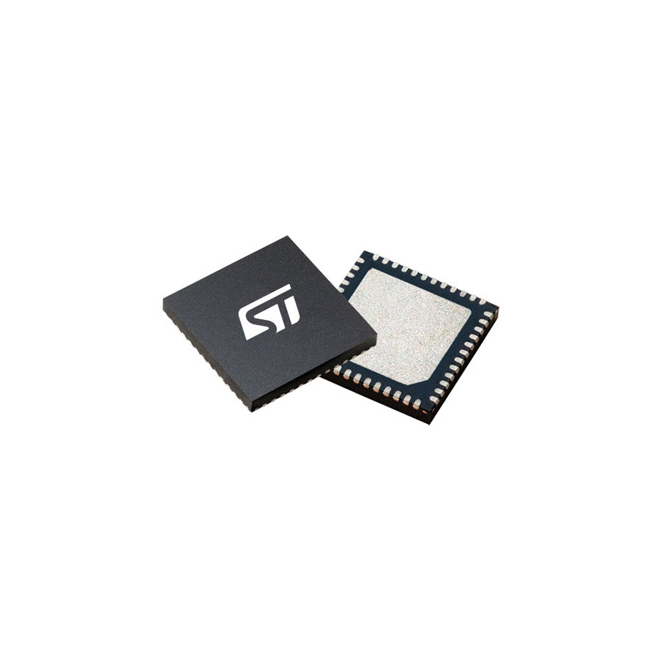
Microcontroller and LoRa SoC
➢ STMicroelectronics STM32WLE5CCU6
48 MHz Arm Cortex-M4 | Integrated sub-GHz LoRa | UFQFPN48: 7 × 7 × 0.6 mm
Operating Mode
Typical Current
Approx. Power
Stop 2 with RTC
1.07 µA @ 3.0 V
3.21 µW
Low-Power Run @ 2 MHz
220 µA @ 3.0 V
0.66 mW
Run @ 48 MHz (SMPS)
3.45 mA @ 3.0 V
10.35 mW
LoRa Receive
4.82 mA @ 3.0 V
14.46 mW
LoRa TX @ +14 dBm
26 mA @ 3.3 V
85.8 mW
MCU energy per 1-minute cycle
≈ 0.71 mJ/min
Assumption: 50 ms at 48 MHz; remaining 59.95 s in Stop 2 with RTC
Selected SoC: STM32WLE5CCU6 — MCU + LoRa in one chip
UFQFPN48 package

